Slide 1
Table Structure Recognition

Slide 2
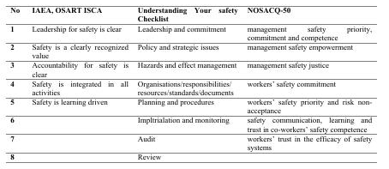

Slide 3
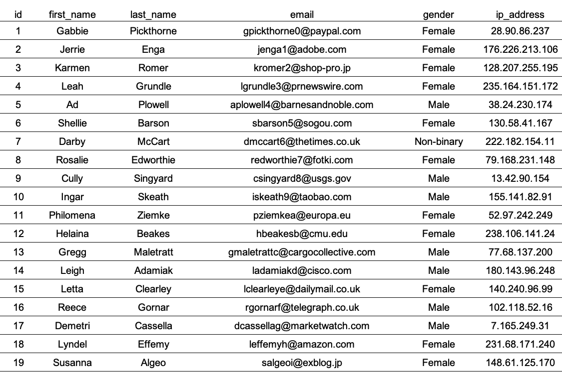

Slide 4
